Slide 1
Chapter 07_03 Greedy Algorithms
Dijkstra’s Algorithm
Single-Source Shortest Paths

Slide 2

Dijkstra’s Algorithm
Consider the single-source shortest-paths problem:
Given a vertex s (called the source) in a weighted connected graph G = (V, E),
find shortest paths to all its other vertices.
The single-source shortest-paths problem looks for
a family of paths,
each path leads from the source to a different vertex in the graph,
some paths may have edges in common.
The algorithm is not interested in a single shortest path that starts at the source and visits all the other vertices.
This could be a much more difficult problem (a version of the traveling salesman problem).

Slide 3
Dijkstra’s Algorithm
The single-source shortest-paths problem:
Given a vertex called the source in a weighted connected graph, find shortest paths to all its other vertices.
Applications of the shortest-paths problem include
transportation planning and packet routing in communication networks, including the Internet.
Less obvious applications, such as, finding shortest paths in social networks, speech recognition, document formatting, robotics, compilers, and airline crew scheduling.
In entertainment, such as path-finding in video games and finding best solutions to puzzles using their state-space graphs.

Slide 4
There are several well-known algorithms for finding shortest paths,
Floyd’s algorithm for the more general all-pairs shortest-paths problem.
Dijkstra’s algorithm, the best-known algorithm for the single-source shortest-paths problem.
This algorithm is applicable to undirected and directed graphs with nonnegative weights only.
The limitation has not impaired the popularity of Dijkstra’s algorithm, this condition is satisfied in most applications.

Slide 5
Dijkstra’s algorithm finds the shortest paths to a graph’s vertices in order of their distance from a given source.
First, it finds the shortest path from the source to a vertex nearest to it, then to a second nearest, and so on.
Before its i^{th} iteration commences, the algorithm has already identified the shortest paths to i-1 other vertices nearest to the source.
The edges of the shortest paths leading to these vertices from the source form a subtree T_{i} of the given graph (Figure 9.10).
Given a graph with n vertices, at the end of i-1th iteration, there forms a subtree T_{i} , including the source V₀

Slide 6
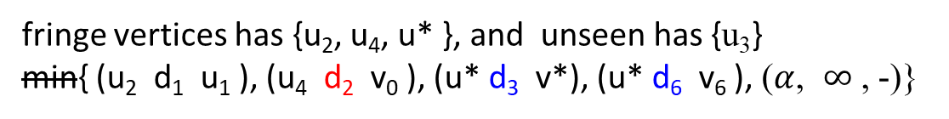

fringe vertices has {u₂, u₄, u* }, and unseen has {u₃}
min{ (u₂ d₁ u₁ ), (u₄ d₂ v₀ ), (u* d₃ v*), (u* d₆ v₆ ), ($α$, $∞$ , -)}
min { u*(v*, D₃+d₃), u*( v₆ D₆+d₆), u₄( v₀ d₂ ) }
u₄
$d4$
u₃
d₂
v*
d₃
u*
Figure 9.10 Idea of Dijkstra’s algorithm. The subtree T₆ of the shortest paths already found is shown in bold (at the end of 5th iteration). The next nearest to the source v₀ vertex, u* , is selected by comparing the lengths of the subtree’s paths increased by the distances to vertices adjacent to the subtree’s vertices.
d₆
v₀
v₆
d₁
u₂
u₁

Slide 7
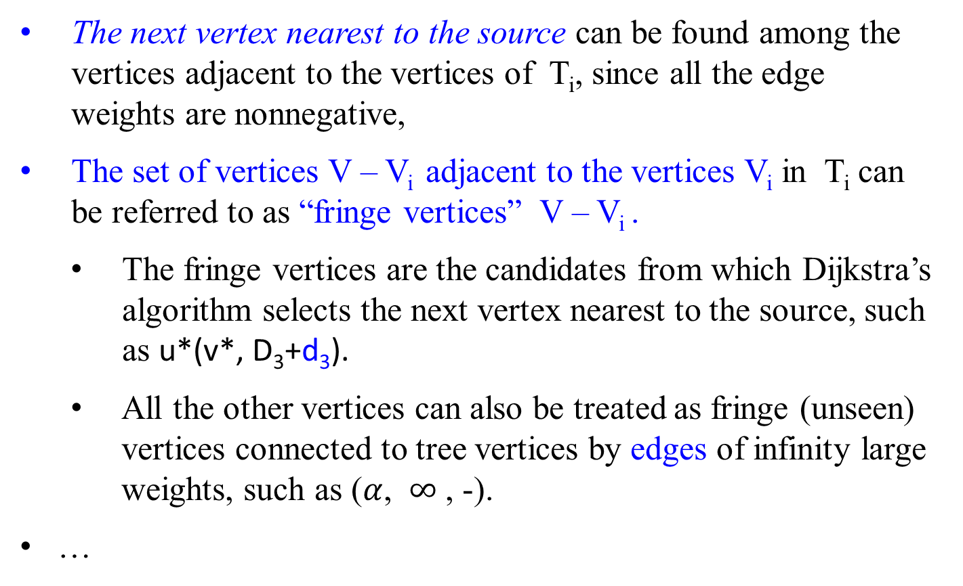
The next vertex nearest to the source can be found among the vertices adjacent to the vertices of T_{i}, since all the edge weights are nonnegative,
The set of vertices V – V_{i} adjacent to the vertices V_{i} in T_{i} can be referred to as “fringe vertices” V – V_{i} .
The fringe vertices are the candidates from which Dijkstra’s algorithm selects the next vertex nearest to the source, such as u*(v*, D₃+d₃).
All the other vertices can also be treated as fringe (unseen) vertices connected to tree vertices by edges of infinity large weights, such as ($α$, $∞$ , -).
…

Slide 8
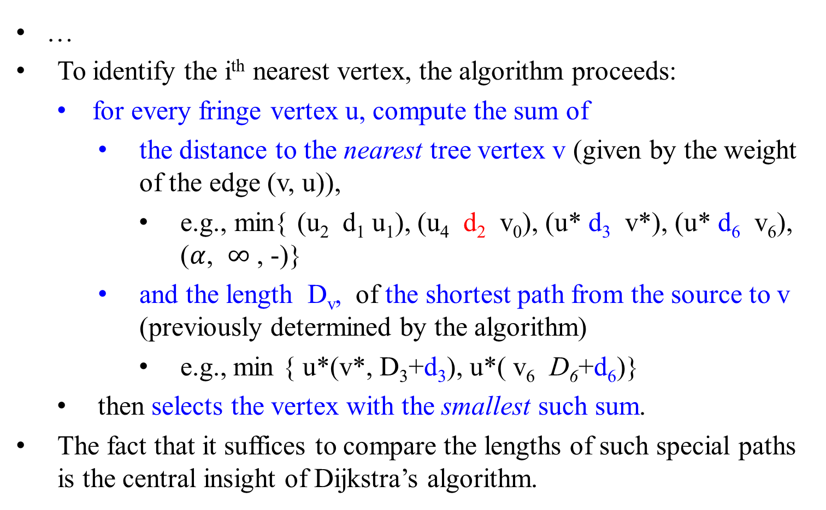



…
To identify the i^{th} nearest vertex, the algorithm proceeds:
for every fringe vertex u, compute the sum of
the distance to the nearest tree vertex v (given by the weight of the edge (v, u)),
e.g., min{ (u₂ d₁ u₁), (u₄ d₂ v₀), (u* d₃ v*), (u* d₆ v₆), ($α$, $∞$ , -)}
and the length D_{v}, of the shortest path from the source to v (previously determined by the algorithm)
e.g., min { u*(v*, D₃+d₃), u*( v₆ D₆+d₆)}
then selects the vertex with the smallest such sum.
The fact that it suffices to compare the lengths of such special paths is the central insight of Dijkstra’s algorithm.
u₄
$d4$
u₃
$d7$
$d5$
d₂
v*
d₃
u*
d₆
v₀
v₆
d₁
u₂
u₁

Slide 9
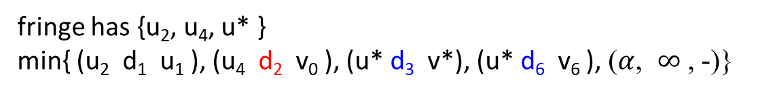
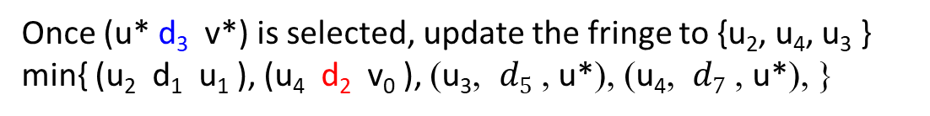
fringe has {u₂, u₄, u* }
min{ (u₂ d₁ u₁ ), (u₄ d₂ v₀ ), (u* d₃ v*), (u* d₆ v₆ ), ($α$, $∞$ , -)}
Once (u* d₃ v*) is selected, update the fringe to {u₂, u₄, u₃ }
min{ (u₂ d₁ u₁ ), (u₄ d₂ v₀ ), ($\text{u}\text{3}$, $d5$ , u*), ($\text{u}\text{4}$, $d7$ , u*), }
After having identified a vertex u* to be added to the tree, we need to perform two operations:
Move u* from the fringe to the set of tree vertices.
For each remaining fringe vertex u that is connected to u* by an edge of weight w(u*, u) such that d_{u*} + w(u*, u) < d_{u}, update the labels of u by u* and d_{u*} + w(u*, u), respectively.
v₀
u*
u
(v₀ - u* - u) of length d_{u*} + w(u*, u).
w(u*, u)
d_{u*}
u_{i}
d_{u}
. . .
(v₀ - u_{i} - u) of length d_{u} .

Slide 10
Figure 9.11 demonstrates the application of Dijkstra’s algorithm to a specific graph.
4
b
c
3
2
5
6
a
7
d
4
e
After vertex a is designated as the source, then have a group of vertices {b, d} which are the adjacent to the vertex a. V_{T} ={a} and V - V_{T} = {b, d, c, e}, where the fringe has {b, d}. We need to calculate the distance (a, b) and (a, d), etc.

Slide 11
Tree vertices | Remaining vertices | Illustration
a(-, 0) min {b(a, 3) c(-, ∞) d(a, 7) e(-, ∞)} b(a, 3)
4
b
c
3
2
5
6
a
7
d
4
e
Pick the vertex b instead of (d 7 a), since (a 3 b) has the minimum distance.
Then V_{T} ={a, b} and V - V_{T} = {d, c, e}.
Add vertex c to the fringe group of vertices {c, d} adjacent to {a, b}.
Compute the distance (c b a), (d b a) with previous (d a), etc.

Slide 12
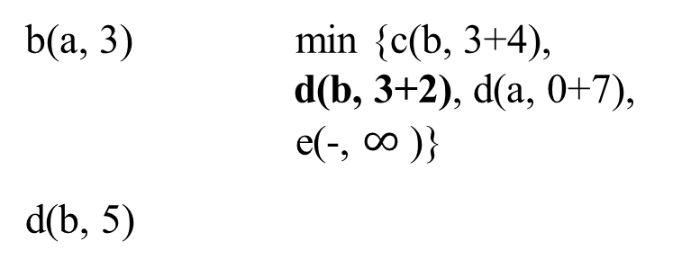
Tree vertices | Remaining vertices | Illustration
a(-, 0) min {b(a, 3) c(-, ∞) d(a, 7)
e(-, ∞)}
4
b
c
b(a, 3) min {c(b, 3+4),
d(b, 3+2), d(a, 0+7), e(-, $∞$ )}
d(b, 5)
3
2
5
6
a
7
d
4
e
Since (d 2 b 3 a) has the minimum distance, pick the vertex d instead of (d 7 a) and (c 4 b 3 a).
Then V_{T} ={a, b, d} and V - V_{T} = {c, e}.
Add vertex e to the group of vertices {c, e} adjacent to {a, b, d}.
Compute the distance (c b a), (c, d b a) and (e d b a), etc.

Slide 13

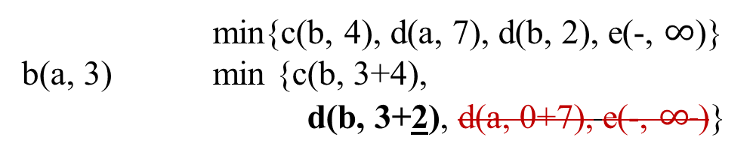
Tree vertices | Remaining vertices | Illustration
b
4
c
a(-, 0) min{b(a, 3) c(-, ∞), d(a, 7), e(-, ∞)}
3
2
5
6
a
7
d
4
e
min{c(b, 4), d(a, 7), d(b, 2), e(-, $∞$)}
b(a, 3) min {c(b, 3+4),
d(b, 3+2), d(a, 0+7), e(-, $∞$ )}
b
4
c
3
2
5
6
min{c(b, 4), c(d, 5}, e(d, 4)}
d(b, 5) min{c(b, 3+4), c(d, 5+5), e(d, 5+4)}
a
7
d
4
e
min{e(d, 4), e(c, 6)}
c(b, 7) min{e(d, 5+4), e(c, 7+6) }
b
4
c
3
2
5
6
a
7
d
4
e

Slide 14

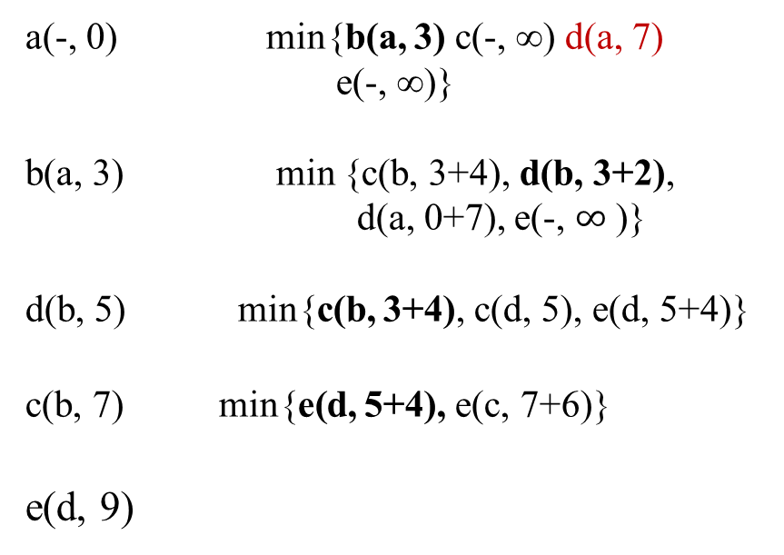
Tree vertices | Remaining vertices | Illustration
a(-, 0) min{b(a, 3) c(-, ∞) d(a, 7) e(-, ∞)}
b(a, 3) min {c(b, 3+4), d(b, 3+2),
d(a, 0+7), e(-, $∞$ )}
d(b, 5) min{c(b, 3+4), c(d, 5), e(d, 5+4)}
c(b, 7) min{e(d, 5+4), e(c, 7+6)}
e(d, 9)
4
b
c
3
2
5
6
a
7
d
4
e
The process is ended for the fringe vertices = { }.
Figure 9.11 Application of Dijkstra’s algorithm. The next closest vertex is shown in bold.

Slide 15

4
b
c
3
2
5
6
a
7
d
4
e
The shortest paths (identified by following nonnumeric labels backward from a destination vertex in the left column to the source) and their lengths (given by numeric labels of the tree vertices) are follows:
from a to b : a – b of length 3
from a to d : a – b – d of length 5
from a to c : a – b – c of length 7
from a to e : a – b – d – e of length 9
Figure 9.11 Application of Dijkstra’s algorithm. The next closest vertex is shown in bold.

Slide 16

An example:
A weighted, directed graph and the steps in Dijkstra’ s algorithm for the given graph.
The vertices in V_{T} and the edges in E_{T} are shaped in yellow and blue color, respectively.

Slide 17
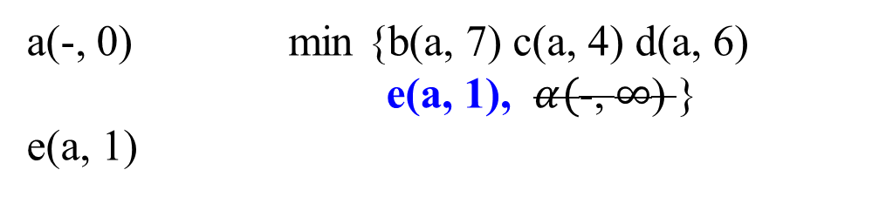
∞
Tree vertices | Remaining vertices | Illustration
a(-, 0) min {b(a, 7) c(a, 4) d(a, 6)
e(a, 1), $α($-, $∞$) }
e(a, 1)
a
7
1
6
4
e
b
1
3
2
d
c
5

Slide 18
∞
Tree vertices | Remaining vertices | Illustration
a(-, 0) min {b(a, 7) c(a, 4) d(a, 6) e(a, 1) }
min {b(a, 7) c(a, 4) d(a, 6) d(e, 1)}
e(a, 1) min {b(a, 7) c(a, 4) d(a, 6) d(e, 1+1)}
d(e, 2)
a
1
7
6
4
e
b
1
3
2
d
c
5

Slide 19
∞
Tree vertices | Remaining vertices | Illustration
a(-, 0) min {b(a, 7) c(a, 4) d(a, 6) e(a, 1) }
e(a, 1) min {b(a, 7) c(a, 4) d(a, 6) d(e, 1+1)}
d(e, 2) min {b(a, 7) b(d, 3) c(a, 4) }
min {b(a, 7) b(d, 2+3) c(a, 4) }
c(a, 4)
a
1
7
6
4
e
b
1
3
2
d
c
5

Slide 20
∞
Tree vertices | Remaining vertices | Illustration
a(-, 0) min {b(a, 7) c(a, 4) d(a, 6) e(a, 1) }
e(a, 1) min {b(a, 7) c(a, 4) d(a, 6) d(e, 1+1)}
d(e, 2) min {b(a, 7) b(d, 2+3) c(a, 4) }
c(a, 4) min { b(a, 7), b(d, 3), b(c, 2)}
min { b(a, 7), b(d, 2+3), b(c, 4+2)}
b(d, 5)
a
1
7
6
4
e
b
1
3
2
d
c
5

Slide 21
∞
Tree vertices | Remaining vertices | Illustration
a(-, 0) min {b(a, 7) c(a, 4) d(a, 6) e(a, 1) }
e(a, 1) min {b(a, 7) c(a, 4) d(a, 6) d(e, 1+1) d(e, 2) min {b(a, 7) b(d, 2+3) c(a, 4) }
c(a, 4) min { b(a, 7), b(d, 2+3), b(c, 4+2)}
b(d, 5)
The shortest paths are :
(a - e) of length 1
(a - e - d) of length 2
(a - c) of length 4
(a - e - d - b) of length 5
Total length = 12
a
1
7
6
4
e
b
1
3
2
d
c
5
The following paths do not exist:
(a – c – d)
(a – c – b)
(a – b)
(a – d)

Slide 22
∞
Tree vertices | Remaining vertices | Illustration
a(-, 0) min {b(a, 7) c(a, 4) d(a, 6) e(a, 1) }
e(a, 1) min {b(a, 7) c(a, 4) d(a, 6) d(e, 1+1) d(e, 2) min {b(a, 7) b(d, 2+3) c(a, 4) }
c(a, 4) min { b(a, 7), b(d, 2+3), b(c, 4+2)}
b(d, 5)
These are not shortest paths:
(a - e) of length 1
(a - e - d) of length 2
(a - c) of length 4
(a - c - b) of length 6
Total length = 13
a
1
7
6
4
e
b
1
3
2
d
c
5
The following paths do not exist:
(a – c – d)
(a – c – b)
(a – b)
(a – d)

Slide 23
An example:
A weighted, directed graph and the steps in Dijkstra’ s algorithm for the given graph.
The vertices in V_{T} and the edges in E_{T} are shaped in blue color, and the fringe has the nodes in yellow color.

Slide 24
d_{u*} + w(u*, u) < d_{u}
Tree vertices | Remaining vertices | Illustration
a(-, -) min{b(a, 3), c(-, ∞), d(-, ∞), e(a, 6), f(a, 5)}
b(a, 3)
1
b
c
3
4
4
6
a
5
f
5
d
V_{T} = { a } and
fringe vertices, V - V_{T} = { b, c d, f, e}
2
6
8
e

Slide 25
d_{u*} + w(u*, u) < d_{u}
Tree vertices | Remaining vertices | Illustration
a(-, -) min{b(a, 3), c(-, ∞), d(-, ∞), e(a, 6), f(a, 5)}
b(a, 3), min{c(b, 3+1), f(b, 3+4), f(a, 5), e(a, 6)}
c(b, 4)
1
b
c
3
4
4
6
a
5
f
5
d
6
2
8
V_{T} = { a, b } and
fringe vertices, V - V_{T} = { c d, f, e}
e
From these two sets, we conclude the distances for vertices which are adjacent to the vertices in V_{T} are:
{(c 1 b), (f 4 b), (f 5 a), (e 6 a)}

Slide 26
d_{u*} + w(u*, u) < d_{u}
Tree vertices | Remaining vertices | Illustration
a(-, -) min{b(a, 3), c(-, ∞), d(-, ∞), e(a, 6), f(a, 5)}
b(a, 3), min{c(b, 1), f(b, 4), f(a, 5), e(a, 6), d(-, ∞), }
min{c(b, 3+1), f(b, 3+4), f(a, 5), f(a, 5), e(a, 6) }
c(b, 4)
1
b
c
3
4
4
6
a
5
f
5
d
6
2
8
V_{T} = { a, b } and
fringe vertices, V - V_{T} = { c d, f, e}
e
From these two sets, we conclude the distances for vertices which are adjacent to the vertices in V_{T} are:
{(c 1 b), (f 4 b), (f 5 a), (e 6 a)}

Slide 27
d_{u*} + w(u*, u) < d_{u}
Tree vertices | Remaining vertices | Illustration
a(-, -) min{b(a, 3), c(-, ∞), d(-, ∞), e(a, 6), f(a, 5)}
b(a, 3), min{c(b, 3+1), f(b, 3+4), f(a, 5), e(a, 6)}
c(b, 4) min{f(b, 3+4), f(c, 4+4), f(a, 5), e(a, 6), d(c,4+6)}
f(a, 5)
1
b
c
3
4
4
6
a
5
f
5
d
6
2
8
e
V_{T} = { a, b, c } and
V - V_{T} = { d, f, e}
From these two sets, we conclude the distances for vertices which are adjacent to the vertices in V_{T} are:
{(f 4 c), (f 4 b), (f 5 a), (e 6 a), (d, 6 c)}

Slide 28
d_{u*} + w(u*, u) < d_{u}
Tree vertices | Remaining vertices | Illustration
a(-, -) min{b(a, 3), c(-, ∞), d(-, ∞), e(a, 6), f(a, 5)}
b(a, 3), min{c(b, 1), f(b, 4), f(a, 5), e(a, 6), d(-, ∞), }
min{c(b, 3+1), f(b, 3+4), f(a, 5), f(a, 5), e(a, 6) }
c(b, 4) min{f(b, 4), f(c, 4), f(a, 5), e(a, 6), d(c, 6)}
min{f(b, 3+4), f(c, 4+4), f(a, 5),
e(a, 6), d(c,4+6) }
f(b, 7)
1
b
c
3
4
4
6
a
5
f
5
d
6
2
8
e
V_{T} = { a, b, c } and
V - V_{T} = { d, f, e}
From these two sets, we conclude the distances for vertices which are adjacent to the vertices in V_{T} are:
{(f 4 c), (f 4 b), (f 5 a), (e 6 a), (d, 6 c)}

Slide 29
d_{u*} + w(u*, u) < d_{u}
Tree vertices | Remaining vertices | Illustration
a(-, -) min{b(a, 3), c(-, ∞), d(-, ∞), e(a, 6), f(a, 5)}
b(a, 3), min{c(b, 1), f(b, 4), f(a, 5), e(a, 6), d(-, ∞), }
min{c(b, 3+1), f(b, 3+4), f(a, 5), f(a, 5), e(a, 6) }
c(b, 4) min{f(b, 4), f(c, 4), f(a, 5), e(a, 6), d(c, 6)}
min{f(b, 3+4), f(c, 4+4), f(a, 5),
e(a, 6), d(c,4+6) }
f(b, 7) min {d(c, 6), d(f, 5), e(f, 2), e(a, 6)}
1
b
c
3
4
4
6
a
5
f
5
d
6
2
8
e
V_{T} = { a, b, c, f } and
V - V_{T} = { d, e}

Slide 30
d_{u*} + w(u*, u) < d_{u}
Tree vertices | Remaining vertices | Illustration
a(-, -) min{b(a, 3), c(-, ∞), d(-, ∞), e(a, 6), f(a, 5)}
b(a, 3), min{c(b, 3+1), f(b, 3+4), f(a, 5), e(a, 6)}
c(b, 4) min{f(b, 3+4), f(c, 4+4), f(a, 5), e(a, 6), d(c,4+6)}
f(a, 5) min{(e(f, 5+ 2), e(a, 6), d(c, 4+6), d(f, 5+5)}
e(a, 6)
1
b
c
3
4
4
6
a
5
f
5
d
6
2
8
e
V_{T} = { a, b, c, f } and
V - V_{T} = { d, e}
From these two sets, we conclude the distances for vertices which are adjacent to the vertices in V_{T} are:
{(e 2 f), (e 6 a), (d, 6 c), (d, 5 f) }

Slide 31
d_{u*} + w(u*, u) < d_{u}
Tree vertices | Remaining vertices | Illustration
a(-, -) min{b(a, 3), c(-, ∞), d(-, ∞), e(a, 6), f(a, 5)}
b(a, 3), min{c(b, 3+1), f(b, 3+4), f(a, 5), e(a, 6)}
c(b, 4) min{f(b, 3+4), f(c, 4+4), f(a, 5), e(a, 6), d(c,4+6)}
f(a, 5) min{(e(f, 5+ 2), e(a, 6), d(c, 4+6), d(f, 5+5)}
e(a, 6) min{d(c, 4+6), d(f, 5+5), d(e, 6+8)}
d(f, 10)
1
b
c
3
4
4
6
a
5
f
5
d
6
2
8
e
V_{T} = { a, b, c, f, e} and
V - V_{T} = { d}
From these two sets, we conclude the distances for vertices which are adjacent to the vertices in V_{T} are:
{(d, 6 c), (d, 5 f), (d, 8 e) }

Slide 32
either
d_{u*} + w(u*, u) < d_{u}
Tree vertices | Remaining vertices | Illustration
a(-, -) min{b(a, 3), c(-, ∞), d(-, ∞), e(a, 6), f(a, 5)}
b(a, 3), min{c(b, 3+1), f(b, 3+4), f(a, 5), e(a, 6)}
c(b, 4) min{f(b, 3+4), f(c, 4+4), f(a, 5), e(a, 6), d(c,4+6)}
f(a, 5) min{(e(f, 5+ 2), e(a, 6), d(c, 4+6), d(f, 5+5)}
e(a, 6) min{d(c, 4+6), d(f, 5+5), d(e, 6+8)}
d(f, 10)
1
b
c
3
4
4
6
a
5
f
5
d
6
2
8
e
V_{T} = { a, b, c, f, e} and
V - V_{T} = { }
Since both d(c, 4+6) and d(f, 5+5) have the same distance, choose either one arbitrarily.

Slide 33
or
d_{u*} + w(u*, u) < d_{u}
Tree vertices | Remaining vertices | Illustration
a(-, -) min{b(a, 3), c(-, ∞), d(-, ∞), e(a, 6), f(a, 5)}
b(a, 3), min{c(b, 3+1), f(b, 3+4), f(a, 5), e(a, 6)}
c(b, 4) min{f(b, 3+4), f(c, 4+4), f(a, 5), e(a, 6), d(c,4+6)}
f(a, 5) min{(e(f, 5+ 2), e(a, 6), d(c, 4+6), d(f, 5+5)}
e(a, 6) min{d(c, 4+6), d(f, 5+5), d(e, 6+8)}
d(c, 10)
1
b
c
3
4
4
6
a
5
f
5
d
6
2
8
e
V_{T} = { a, b, c, f, e} and
V - V_{T} = { }

Slide 34
The shortest paths (identified by following nonnumeric labels backward from a destination vertex in the left column to the source) and their lengths (given by numeric labels of the tree vertices) are follows:
from a to b : a – b of length 3
from a to c : a – b – c of length 4
from a to f : a – f of length 5
from a to b : a – e of length 6
from a to d : a – f – d of length 10
Figure shows the application of Dijkstra’s algorithm. The next closest vertex is shown in bold.
1
b
c
3
4
4
6
a
5
f
5
d
6
2
8
e

Slide 35
Dijkstra’s algorithm vs Prim’s algorithm.
Both of them construct an expanding subtree of vertices by selecting the next vertex from the priority queue of the remaining vertices.
But, they solve different problems and therefore operate with priorities computed in a different manner:
Dijkstra’s algorithm compares path lengths and therefore must add edge weights,
while Prim’s algorithm compares the edge weights as given.

Slide 36
The pseudocode of Dijkstra’s algorithm.
The set V_{T} of vertices for which a shortest path has already been found .
the priority queue Q of the fringe vertices.
V_{T} contains a given source vertex and the fringe contains the vertices adjacent to it after iteration 0 is completed.

Slide 37
Algorithm Dijkstra(G, s)
//Dijkstra’s algorithm for single-source shortest paths
Input: A weighted connected graph G = (V, E) with nonnegative weights and its vertex Output: The length d_{v} of a shortest path from s to v and its penultimate vetex p_{v} for every
vertex v in V
Initialize (Q) //Initialize priority queue to empty
for every vertex v in V
{ d_{v} ← ∞; p_{v} ← null
Insert(Q, v, d_{v} ) //initialize vertex priority in the priority queue }
d_{s} ← 0; Decrease(Q, s, d_{s} ) //update priority of s with d_{s}
V_{T} ← Ø
for i ← 0 to |V| - 1 do {
u* ← DeleteMin(Q) //delete the minimum priority element
V_{T} ← V_{T} U { u* }
for every vertex u in V - V_{T} that is adjacent to u* do {
if d_{u*} + w(u*, u) < d_{u}
{ d_{u} ← d_{u*} + w(u*, u);
p_{u} ← u*
Decrease (Q, u, d_{u}) } //end if
} //end for
}//end for
The next to the last

Slide 38

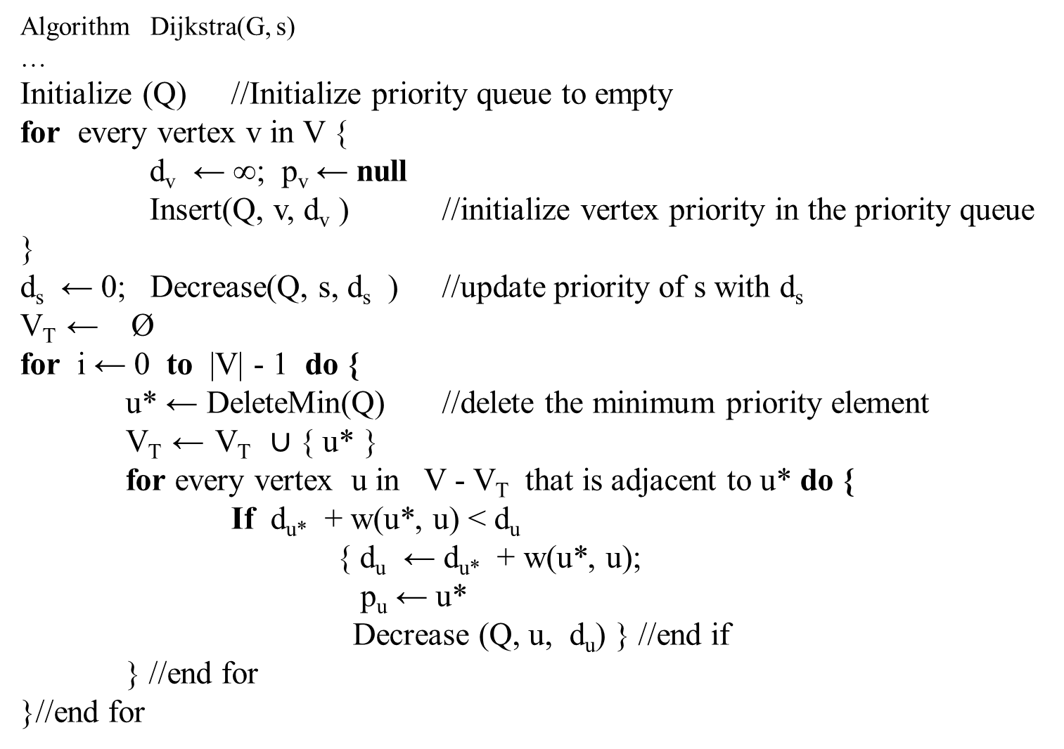
Algorithm Dijkstra(G, s)
…
Initialize (Q) //Initialize priority queue to empty
for every vertex v in V {
d_{v} ← ∞; p_{v} ← null
Insert(Q, v, d_{v} ) //initialize vertex priority in the priority queue }
d_{s} ← 0; Decrease(Q, s, d_{s} ) //update priority of s with d_{s}
V_{T} ← Ø
for i ← 0 to |V| - 1 do {
u* ← DeleteMin(Q) //delete the minimum priority element
V_{T} ← V_{T} $∪$ { u* }
for every vertex u in V - V_{T} that is adjacent to u* do {
If d_{u*} + w(u*, u) < d_{u}
{ d_{u} ← d_{u*} + w(u*, u);
p_{u} ← u*
Decrease (Q, u, d_{u}) } //end if
} //end for
}//end for

Slide 39
The time efficiency of Dijkstra’s algorithm depends on the data structures used for implementing the priority queue and for representing an input graph itself.
For the reasons explained in the analysis of Prim’s algorithm before, it is in ϴ( |V|² ) for graphs represented by their weight matrix and the priority queue implemented as an unordered array.
For graphs represented by their adjacency lists and the priority queue implemented as a min-heap, it is in ϴ( |E | log |V |).
A still better upper bound can be achieved for both Prim’s and Dijkstra’s algorithms if the priority queue is implemented using a sophisticated data structure called the Fibonacci heap ϴ( |E | + |V | log |V |). (e.g., [Cor09]).
However, its complexity and a considerable overhead make such an improvement primarily of theoretical value.

Slide 41
Chapter 07_04
Greedy Algorithms:
Scheduling and
Huffman Trees Code

